Slide 1
IIT140002 CHE MOHAMMAD FAKHRI AIMI BIN CHE LUDIN
IIT140004 MUHAMMAD RIDZUAN BIN DOLAH
NEX170412 LIU WEI

Slide 2
Physical Topology
How network devices are physically connected
How the devices are actually connected to each other
Such as cables, wireless connectivity and more

Slide 3
Logical Topology
How network devices appear to be connected to each other

Slide 4
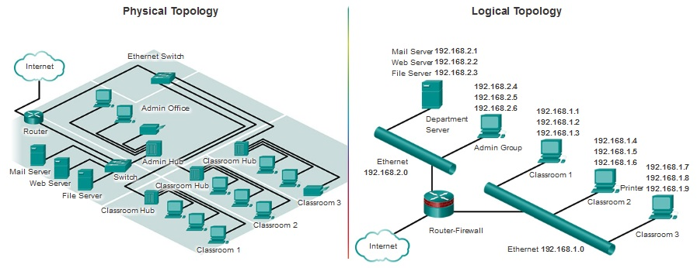
Physical and Logical Topology diagram

